Slide 1
Lightweight Acoustic LINING Design for Aircraft fuselage ME613 Commercial Airplane Group – Team 4
Bryce Geesey - Ben Masters - Nitin Pauletti - Jinghe Yu

Slide 2
Design Characteristics
Goals + Constraints
Assumptions
Frequency Analysis Range
100-20k Hz
Emphasis on the Speech Interference Range (SIR) (500-4k Hz)
Lightweight
Total combined m_{s} of all screens < 2 kg/m²
High Performance
High TL throughout the entire frequency range
Thin Screens
Reasonable max of 100 screens could fit in the air gap
Incompressible Flow
Negligible Inertial Effects

Slide 3
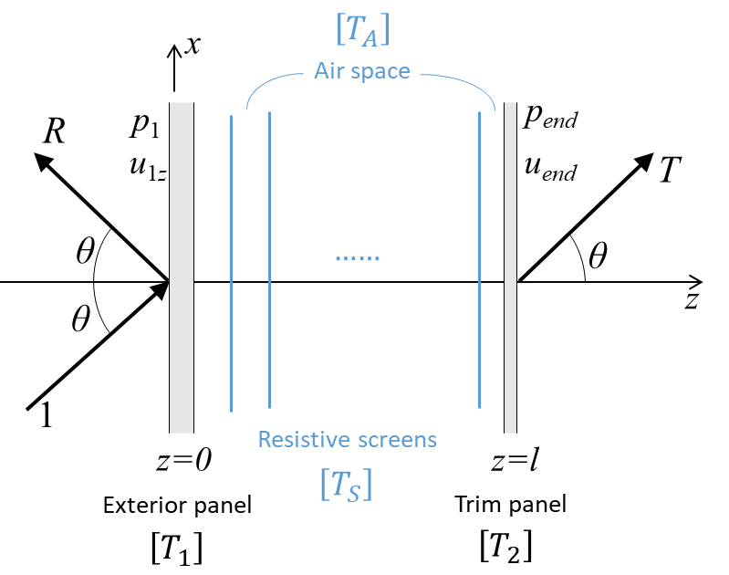

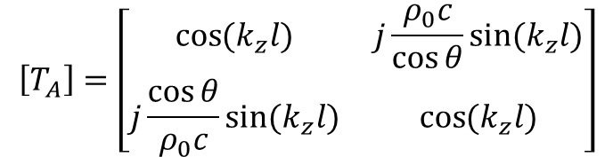
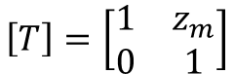
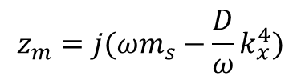
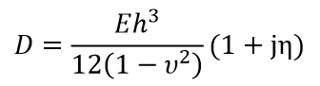
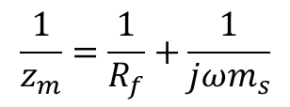
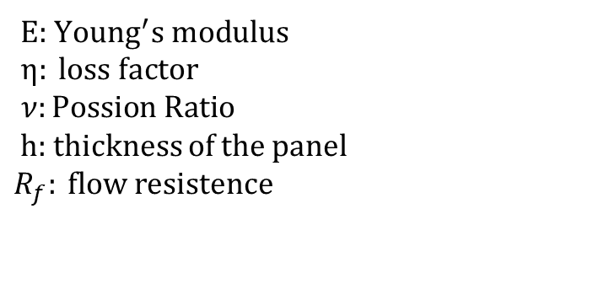
System Illustration and Modeling
Transfer Matrix Modeling
For air space:
For panels:
Flexurally-stiff panel:
Flexible, resistive screen:

Slide 4
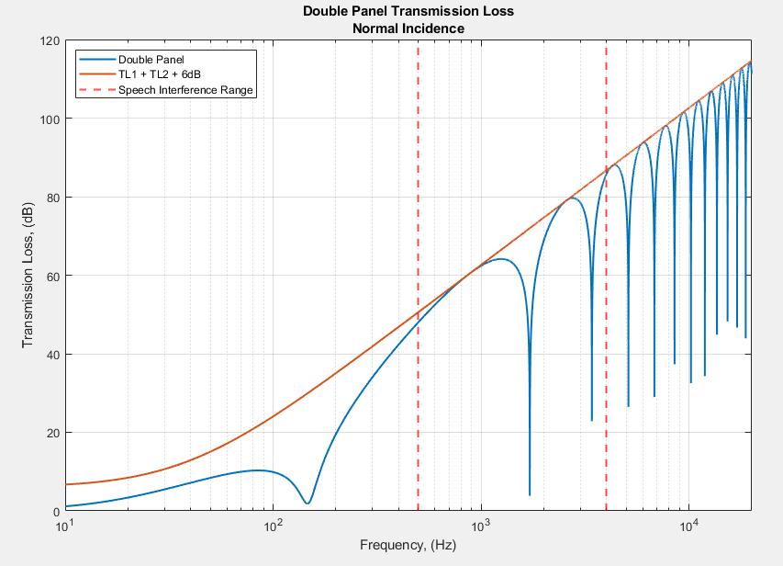
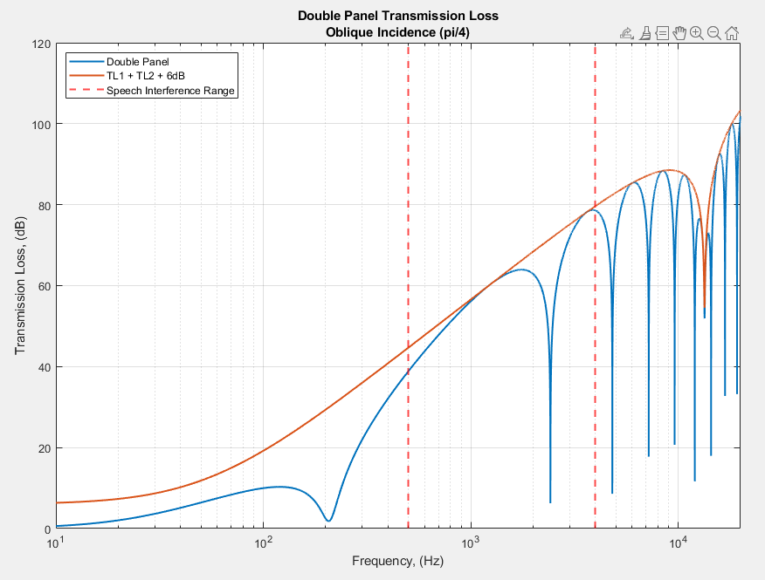
Part 1 – i) Unlined Double Panel System
Double Panel System: Normal and Oblique Incidence
M-A-M Resonance
Coincidence Frequency

Slide 5
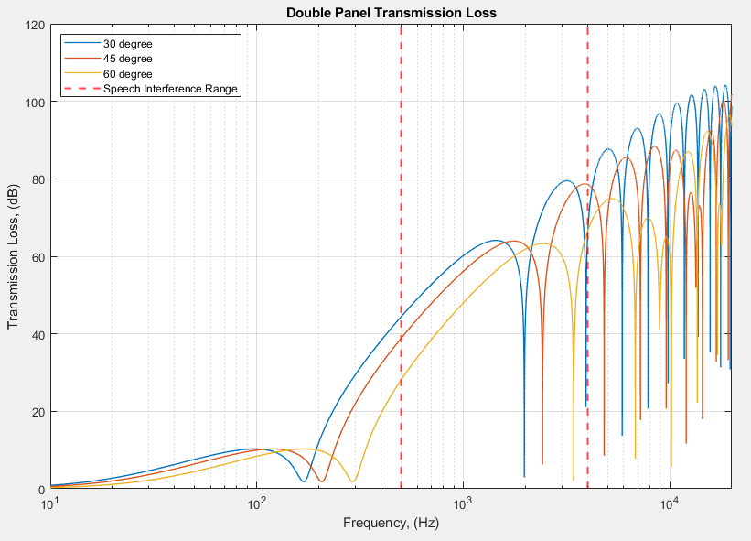
Part 1 – i) Unlined Double Panel System, cont.
Double Panel System: Variation with Angle of Incidence
As angle of incidence increases
Mass-Air-Mass resonance frequency increases
Depth resonance frequency increases
Coincidence frequency decreases
60 degree Coincidence Freq.
45 degree Coincidence Freq

Slide 6
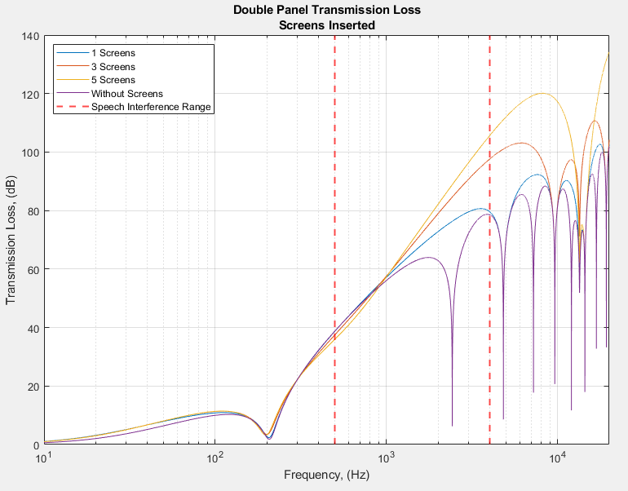
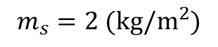
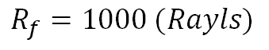
Part 1 – ii) Insertion of Flexible Resistive Screens
Insertion of various number of screens into system
Arbitrarily Chosen Values:
$$R_{f}=1000 (Rayls)$$
in total
With insertion of screens
Mass-Air-Mass resonance and coincidence frequency changes little.
Depth resonances are eliminated.
For a constant total mass, the more screens inserted, the higher the transmission loss is.

Slide 7
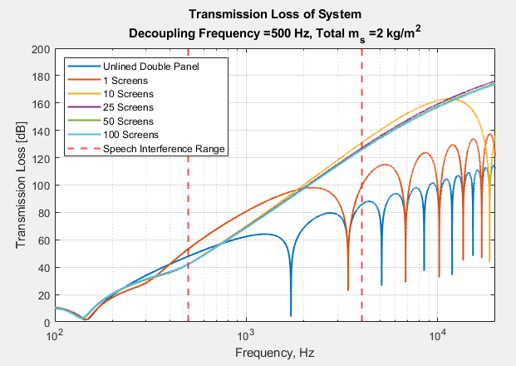
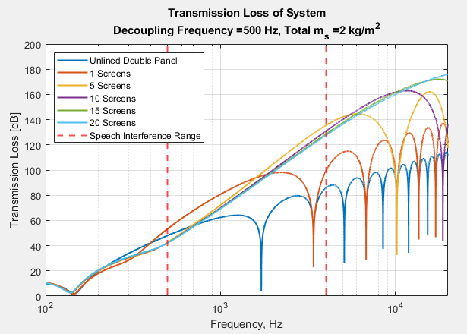
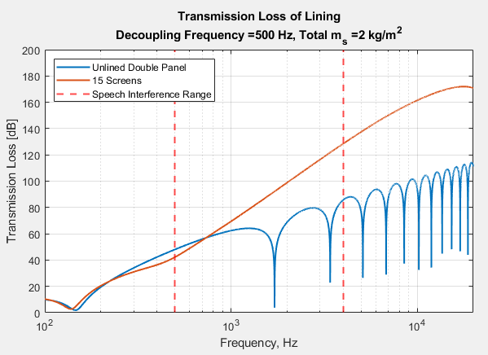
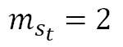
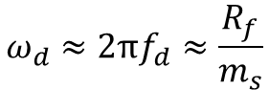
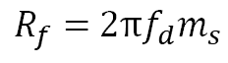
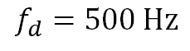
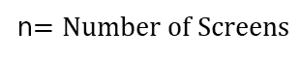
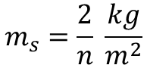
Part 1 – iii) The Solution, Parameter Selection
Using identical screens
Number of Screens
Decoupling Frequency of Screens:
Maximize Total Mass of Screens:
Flow Resistance:
$$ω_{d}≈2πf_{d}≈\frac{R_{f}}{m_{s}}$$
$$m_{s}=\frac{2}{n} \frac{kg}{m^{2}}$$
$$m_{s_{t}}=2$$
$R_{f}=$ $2πf_{d}m_{s}$
$$f_{d}=500 Hz$$
n$=Number of Screens$
Wide Range of Screens
Convergence Test to Avoid High Frequency Depth Resonances
Minimum Number of Screens to Avoid High Frequency Depth Resonances

Slide 8
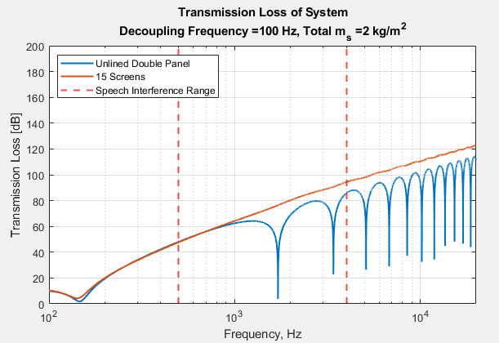
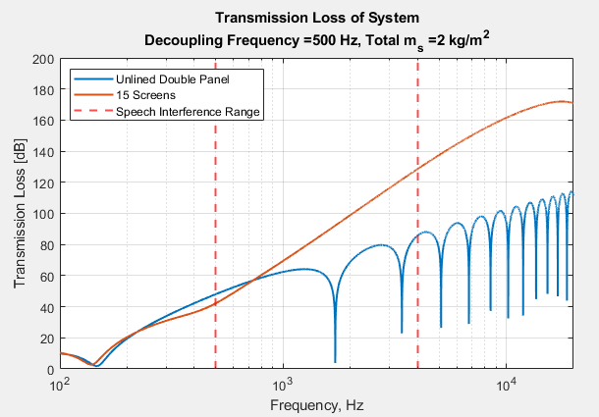
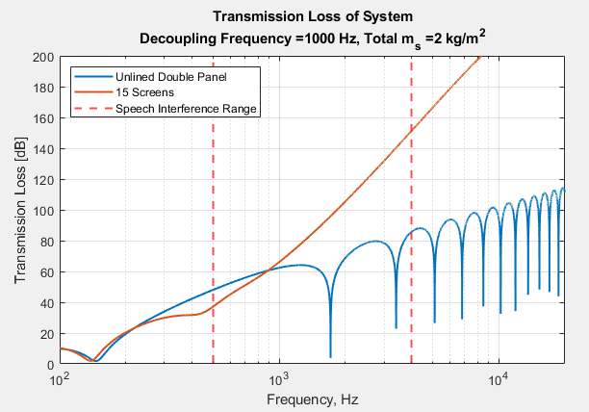
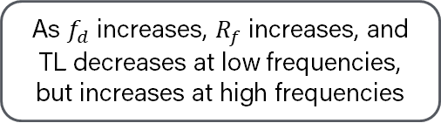
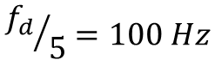
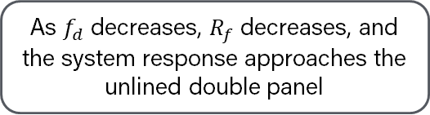
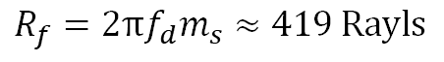
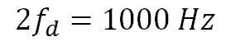
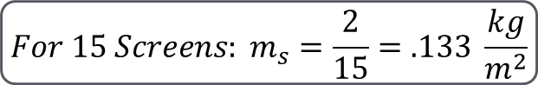
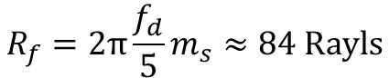
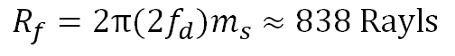
Part 1 – iii) The Solution, Parameter Selection, cont.
$${For 15 Screens: m}_{s}=\frac{2}{15}=.133 \frac{kg}{m^{2}}$$
Decoupling Frequency
$${f_{d}}/5=100 Hz$$
$$f_{d}=500 Hz$$
${2f}_{d}=1000 Hz$
$$R_{f}=2π\frac{f_{d}}{5}m_{s}≈84 Rayls$$
$$R_{f}=2πf_{d}m_{s}≈419 Rayls$$
$$R_{f}=2π(2f_{d})m_{s}≈838 Rayls$$
As $f_{d}$ decreases, $R_{f}$ decreases, and the system response approaches the unlined double panel
As $f_{d}$ increases, $R_{f}$ increases, and TL decreases at low frequencies, but increases at high frequencies

Slide 9
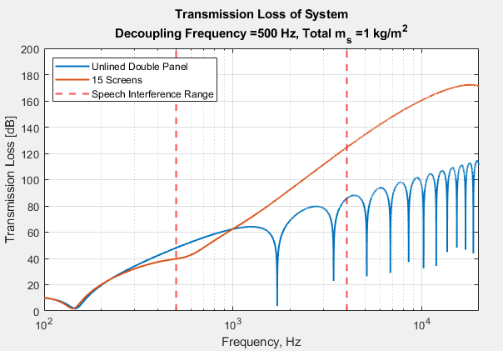

Part 1 – iii) The Solution, Parameter Selection, cont.
Verification of Mass Assumption
$$Holding R_{f},n constant$$
By decreasing the Mass we see decreased Transmission Loss in low frequency range
Therefore, the choice of using the maximum permitted Mass has been validated

Slide 10

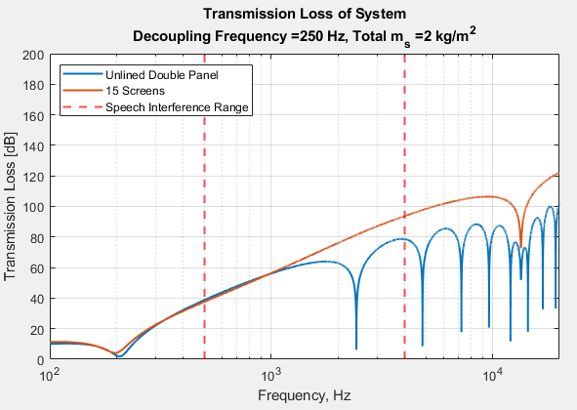
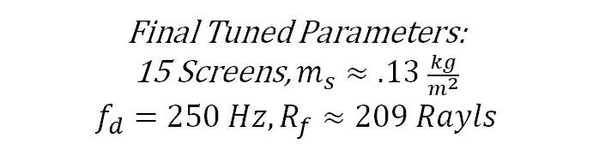
Part 1 – iii) The Solution, Result
Normal Incidence
Oblique Incidence (π/4)
Final Tuned Parameters:
15 Screens, $m_{s}≈.13 \frac{kg}{m^{2}}$
$$f_{d}=250 Hz, R_{f}≈209 Rayls$$
Observations
Slight decrease in TL in the frequency region slightly greater than M-A-M
Possible result of introduction of M-A-M Resonances between Screens
Coincidence Frequency does still appear for oblique incidence

Slide 11
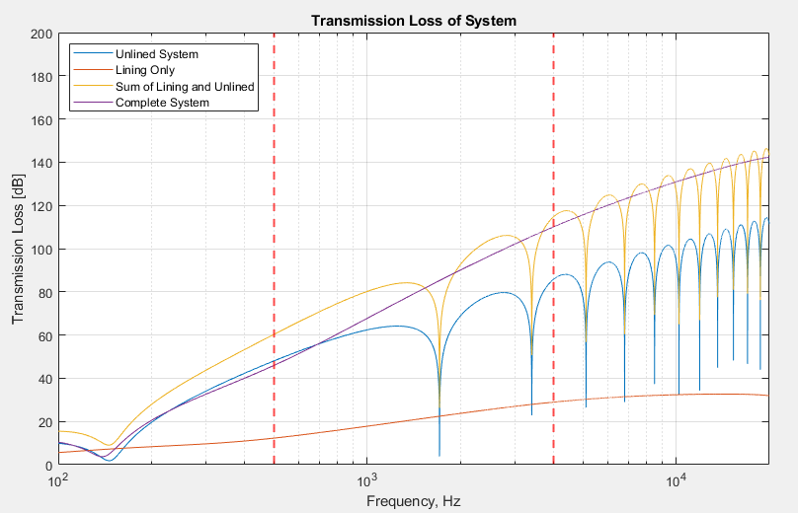
Part 1 – iv) The Lining
Transmission Loss of Lining + Comparisons
Lining Conclusions
Peaks of sum of the lining and unlined system TL is greater than actual system TL
Depth resonances are eliminated in the target frequency range

Slide 12
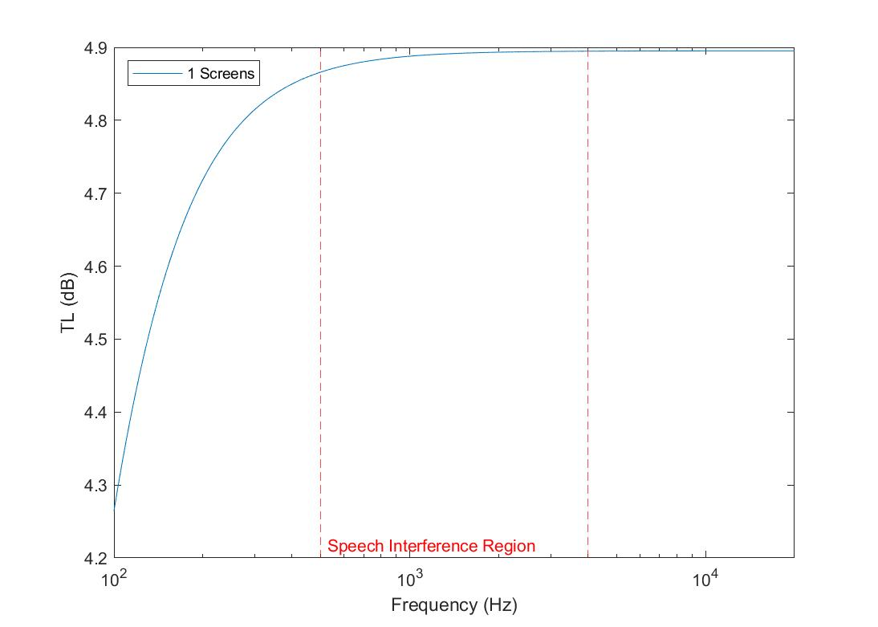
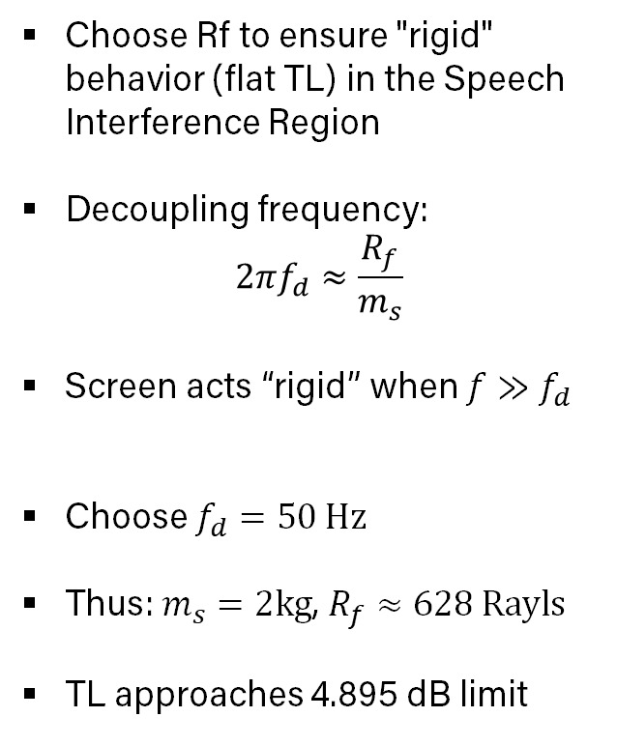
Part 2 – Transmission Through a Single Screen
Choose Rf to ensure "rigid" behavior (flat TL) in the Speech Interference Region
Decoupling frequency:
$$2πf_{d}≈\frac{R_{f}}{m_{s}}$$
Screen acts “rigid” when $f≫f_{d}$
Choose $f_{d}=50 Hz$
Thus: $m_{s}=2kg$, $R_{f}≈628 Rayls$
TL approaches 4.895 dB limit

Slide 13
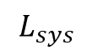
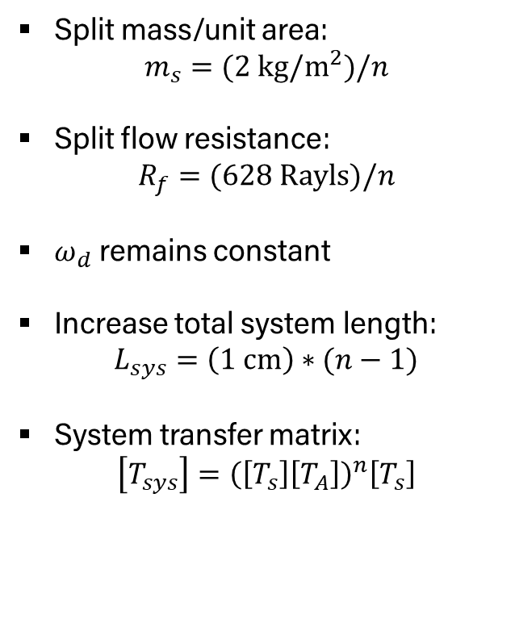
Part 2 – Convergence of Halving the Screens
Split mass/unit area:
$$m_{s}=(2 kg/m^{2})/n$$
Split flow resistance:
$$R_{f}=(628 Rayls)/n$$
$ω_{d}$ remains constant
Increase total system length:
$$L_{sys}=\left(1 cm\right)∗(n−1)$$
System transfer matrix:
$$\left[T_{sys}\right]={\left(\left[T_{s}\right]\left[T_{A}\right]\right)}^{n}\left[T_{s}\right]$$
n=1
n=2
n=4
n=8
$$L_{sys}$$

Slide 14
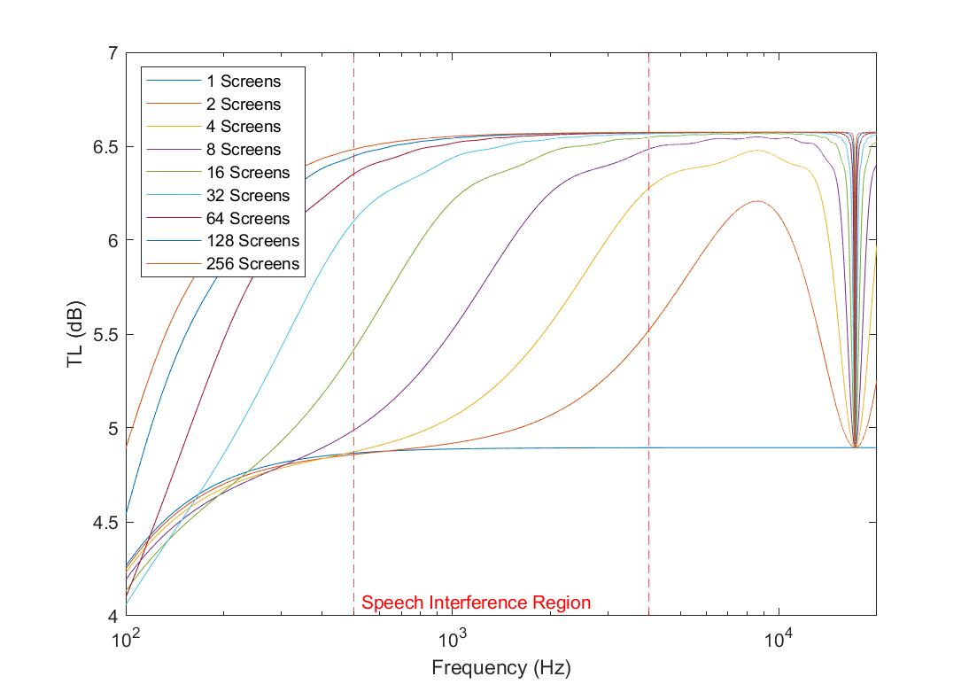
Part 2 – Convergence of Halving the Screens
Depth resonances appear for multiple screens, TL dips to the single screen line
TL follows single screen then transitions to a 6.573 dB limit as n increases
Depth resonances become narrower as n increases
After sufficient halving operations, system behaves like a single rigid resistive screen in Speech Interference Region but at a higher TL and with depth resonances
1 cm air gap between screens

Slide 15
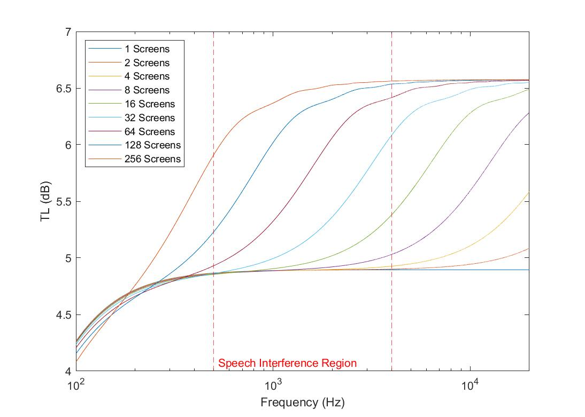
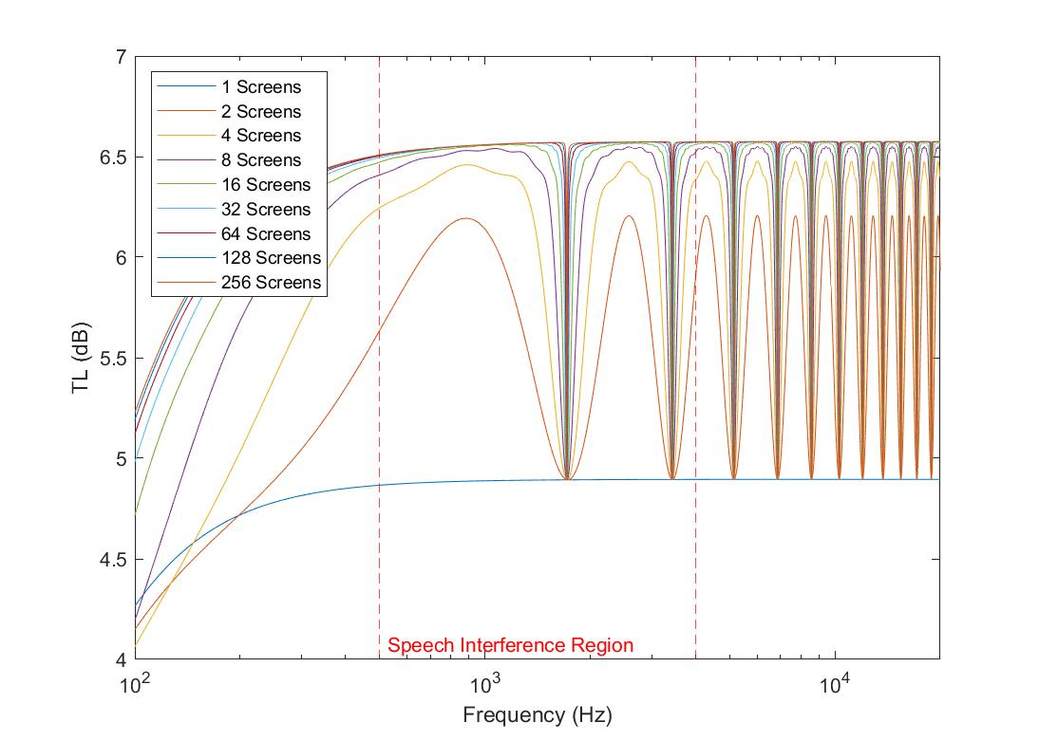
Part 2 – Air Space Depth Investigation
1 mm air gap between screens
10 cm air gap between screens
Smaller air gaps:
Same TL limits
Depth resonances shift right, above 20kHz
Transition now occurs in the SIR for n=256
Larger air gaps:
Same TL limits
Depth resonances shift left
Depth resonances in the SIR for all n

Slide 16
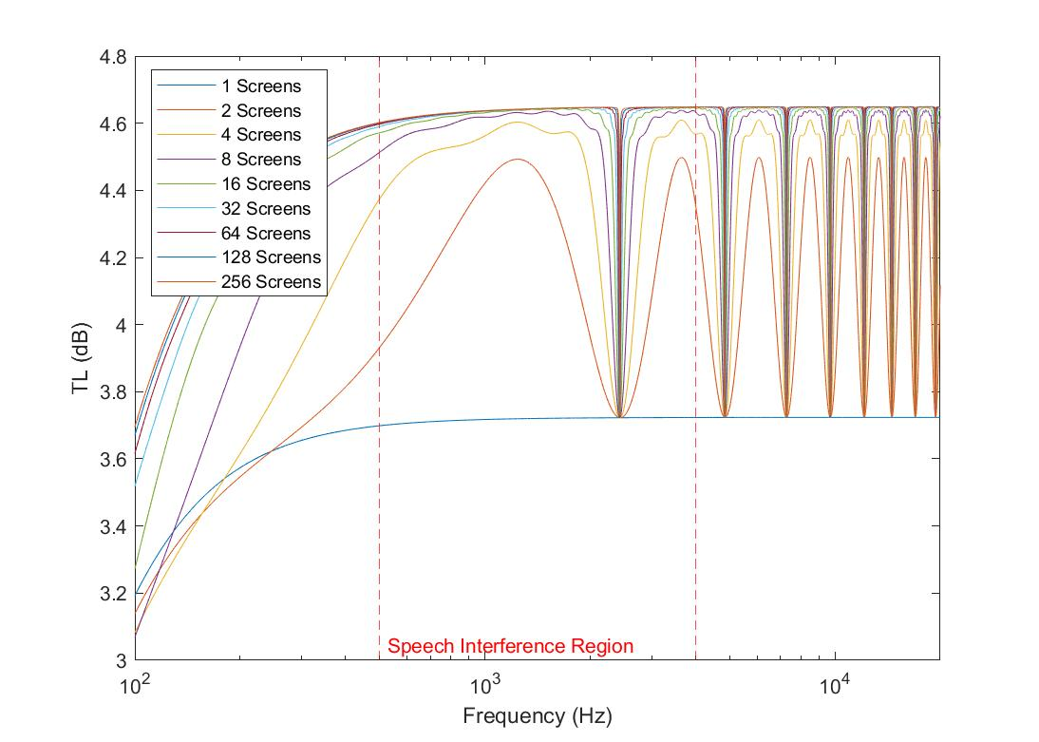
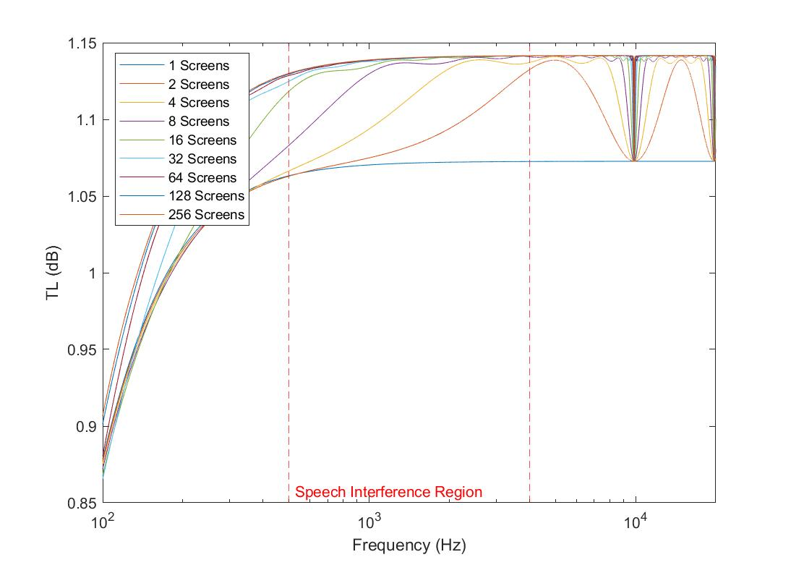
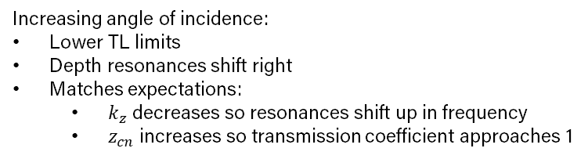
Part 2 – Angle of Incidence Investigation
45° angle of incidence
80° angle of incidence
Increasing angle of incidence:
Lower TL limits
Depth resonances shift right
Matches expectations:
$k_{z}$ decreases so resonances shift up in frequency
$z_{cn}$ increases so transmission coefficient approaches 1

Slide 17
Thank You
Questions?

